Slide 1
Installation Guide
Shaken Baby Simulator

Slide 2
Recommended Educational Prerequisites
The recommended formal education for a thorough understanding of the project described within these slides is listed as follows.
Extensive Knowledge in Computer Science / Computer Engineering
Pulse Width Modulation
General Purpose Electronic Prototyping / Electronic Engineering
Formal Software Requirements Specification Training / Project Analysis
Intermediate Circuit Python Programming Experience
RP2040 PIO Assembly Language Expertise
Ohm’s Law
Amdahl’s Law
Pareto’s Principle

Slide 3
Tools Used
Adafruit Learn - https://learn.adafruit.com/guides/beginner
Mu Text Editor - https://codewith.mu/en/download
Python 3- https://docs.python.org/3/
Circuit Python - https://circuitpython.org/

Slide 4
Required Parts
Adafruit #4884 – Adafruit Feather RP2040
https://www.adafruit.com/product/4884
Adafruit LIS3DH Triple-Axis Accelerometer (+-2g/4g/8g/16g)
https://www.adafruit.com/product/2809
Adafruit Bicolor LED Square Pixel Matrix with I2C Backpack
https://www.adafruit.com/product/902
Adafruit I2S 3W Class D Amplifier Breakout - MAX98357A
https://www.adafruit.com/product/3006

Slide 5
Required Parts
Lithium Ion Polymer Battery - 3.7v 400mAh
https://www.adafruit.com/product/258
Speaker - 40mm Diameter - 4 Ohm 3 Watt
https://www.adafruit.com/product/3968

Slide 6
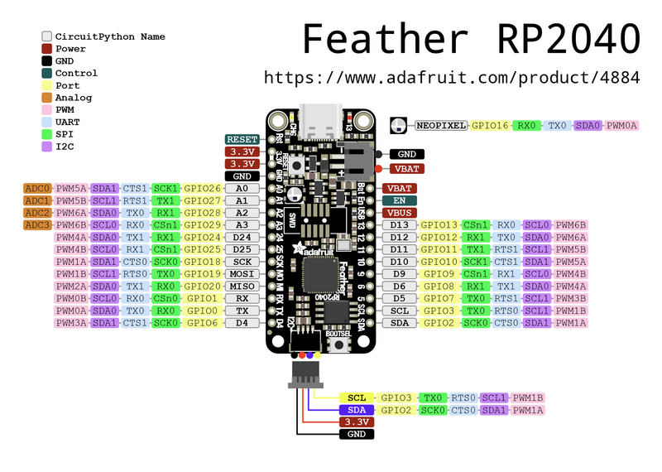
Feather RP2040 Setup Guide
https://learn.adafruit.com/adafruit-feather-rp2040-pico
Plug Device In to Computer
Using cable that supports data / charging
Follow this guide next
https://learn.adafruit.com/adafruit-feather-rp2040-pico/circuitpython

Slide 7
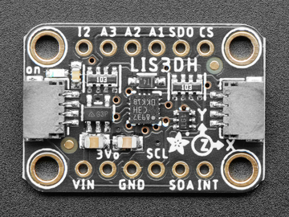
Accelerometer Guide
Assembly
https://learn.adafruit.com/adafruit-lis3dh-triple-axis-accelerometer-breakout/assembly
Programming
https://learn.adafruit.com/adafruit-lis3dh-triple-axis-accelerometer-breakout/python-circuitpython

Slide 8
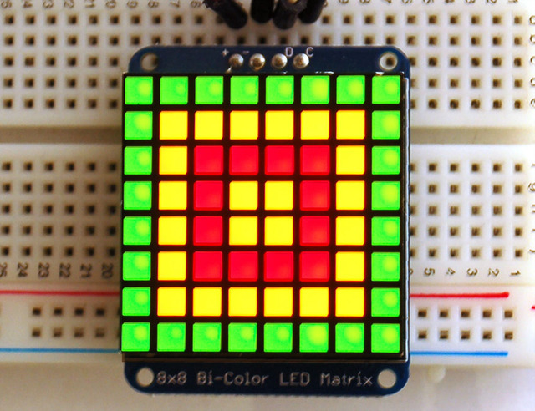
Adafruit Bicolor LED Square Pixel Matrix with I2C Backpack
https://learn.adafruit.com/adafruit-led-backpack/bi-color-8x8-matrix-assembly - (DON’T INSTALL INCORRECTLY)
https://learn.adafruit.com/adafruit-led-backpack/bi-color-8x8-matrix-circuitpython-wiring-and-setup
https://learn.adafruit.com/adafruit-led-backpack/bi-color-8x8-matrix-circuitpython-and-python-usage

Slide 9
Follow the Schematic Provided
The electronic schematic provides detailed instruction of how the circuit should be assembled.
Various electronic debugging may be necessary.

Slide 10
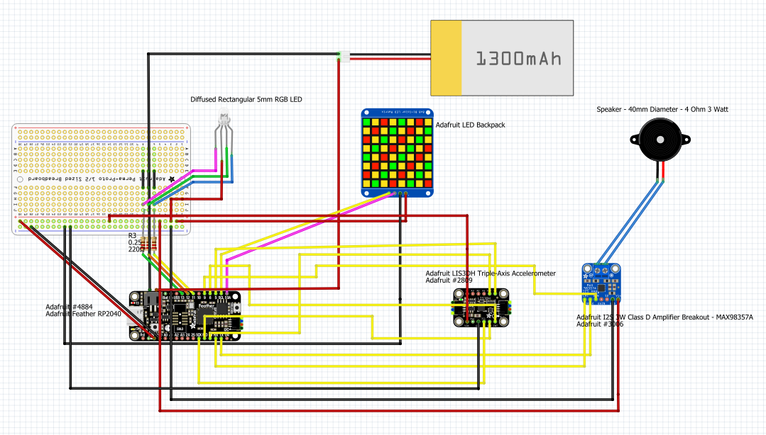

Slide 11
Install the RGB LEDs
Learn about PWM (Pulse Width Modulation).
Install six RGB LEDs in parallel configuration within the schematic used in the previous instruction slide.
Drill 6 holes ¼ inch wide into the silicone brain.
Insert each RGB LED in the following configuration.
2 in the front.
2 on the sides, one on each side.
2 in the back.

Slide 12
Combine Components
Assemble all the components together and load the prototype_final_code_with_RGB_LED code into the RP2040.
Disassemble doll, remove padding inside and put all the components within the doll.

Slide 13
Need Help?
Join the Discord Adafruit server for any questions related to electronic debugging and configuration.
Utilize various online maker blogs and tutorials.

